Slide 1
A Genetic Algorithms thing
Marcel Englmaier
Michael Sharp

Slide 2
Overview of our thing
Genetic Algorithm
Can model mutation
Or diseases(like STDs, not STIs)
Or stuff that travels from parent to child
We don’t want to lose data
Multiple children through randomness

Slide 3
A Genetic Algorithm in a powerpoint slide(but not a nutshell)
[Start] Generate random population of n chromosomes (suitable solutions for the problem)
[Fitness] Evaluate the fitness f(x) of each chromosome x in the population
[New population] Create a new population by repeating following steps until the new population is complete
[Selection] Select two parent chromosomes from a population according to their fitness (the better fitness, the bigger chance to be selected)
[Crossover] With a crossover probability cross over the parents to form a new offspring (children). If no crossover was performed, offspring is an exact copy of parents.
[Mutation] With a mutation probability mutate new offspring at each locus (position in chromosome).
[Accepting] Place new offspring in a new population
[Replace] Use new generated population for a further run of algorithm
[Test] If the end condition is satisfied, stop, and return the best solution in current population
[Loop] Go to step 2

Slide 4
Where we are at
We just made a presentation.
We wrote a small paper
And a small proposal
And some brainstorming
Now it’s on to the programming
We’ve done some
Not a lot
But we could finish the inline version pretty quickly, so we’ll get on that and finish it up

Slide 5
Possible Approaches
Cuda vs. OpenMP
Lots of matrix stuff, also one big loop, maybe two
First loop to set up matrix of suitable parents
Second loop to do the matrix stuff
This is the part we could do in Cuda
But will we?
Maybe. We’ll make 2 versions: purely OpenMP and OpenMP+Cuda and see what happens to performance

Slide 6
Possible Approaches part 2
How about the children?
Quantity is random, but no more than 5
If we get an overflow of population, say 2x original parent count, we’ll implement natural selection.
What sort of traits will we be focussing on:
Gender
Hair color
Skin tone
Any suggestions?

Slide 7
What parts are paralyzable(Michael’s word)
Choosing Parents loop
Creating Kids loop
Natural Selection loop

Slide 8
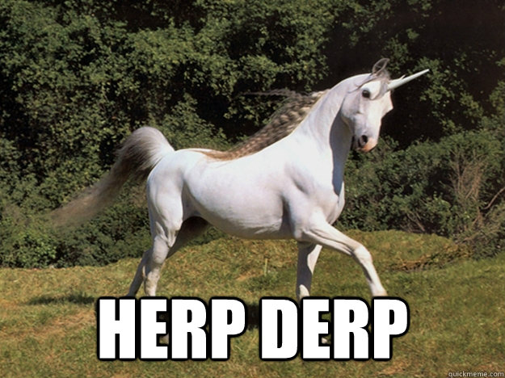
What you think we’re doing

Slide 9
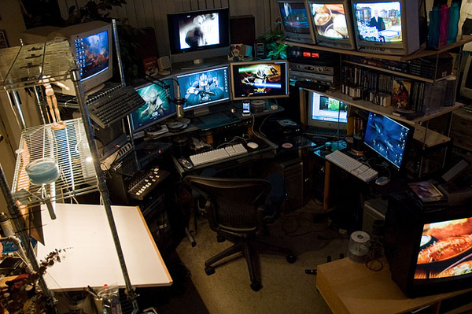
What we think we’re doing

Slide 10
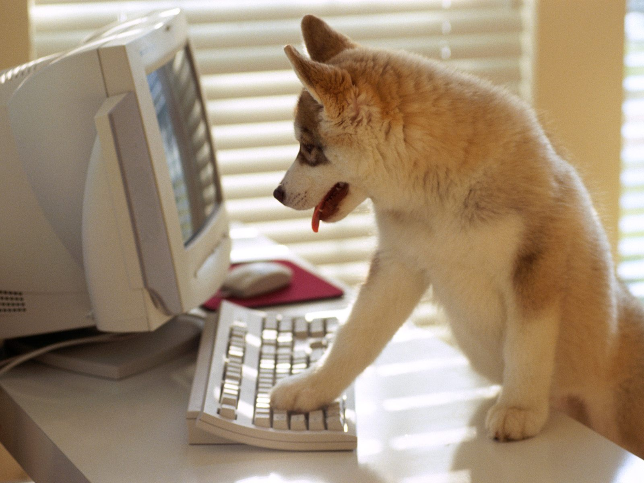
What we’re actually doing

Slide 11

What we should be doing

Slide 12
One last slide
Are you not entertained‽(<-that’s an interrobang, it’s the holy offspring of a ? And a !)
Any suggestions?
No, we will not stop being hilarious
Or embarrassing to ourselves
Yes, culling a population seems crude, but think of the memory!(and the children) where will they be able to live with old sick people everywhere?

